Slide 1

Research: Impect of Social Network.

Slide 2
1. Introduction
Purpose Research question, Objectives, Methodology.

Slide 3
98.9%
Use social network everyday.

Slide 4
What role social network plays in our overall well-being of life as a student?

Slide 5
OBJECTIVES
To find the how social networking affecting our relationships with family and friends.
To find the impact of social networks on our mental health and state of mind.
To find the effects of social network on physical health.
To find the impact of social networking sites on students academic and learning process.

Slide 6
METHODOLOGY
It is a Quantitative.
Online Survey.
125 participants were students.
Pie charts to show percentage.
Bar charts for qualitative data.

Slide 7
2. Tools & Statistics on Social Network Platforms.
Purpose Research on Social sites & Statistics of users.

Slide 8

Effects of Social Networks in our Daily Life
Communication and Connection
Marketing
Youth’s Life
Entertainment

Slide 9
Using Purpose of Social Network sites
Class | Data
Communication | 24.6%
Youth using for Time pass | 31.5%
Marketing | 20.4%
Entertainment | 23.5%
Most of the users are Youth
Broadly using for better communication
Now days purpose of Marketing and Entertainment growing up.

Slide 10
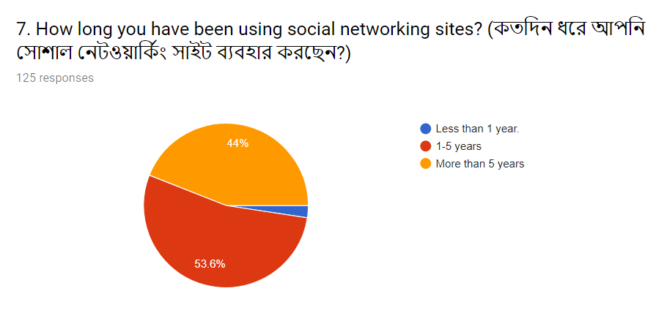
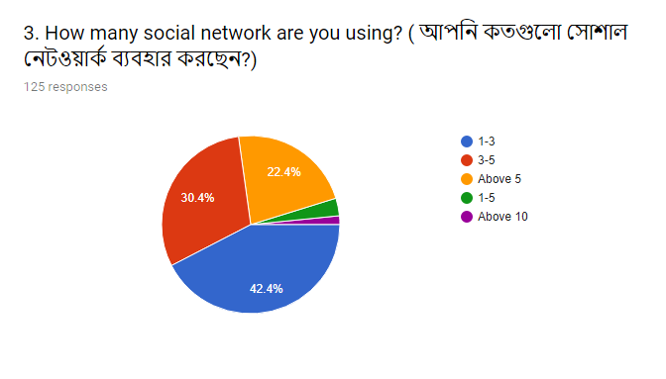
Our survey result on How many Social networks used buy people and which is mostly used.

Slide 11

Leading Social Networks Worldwide
Based on International reports and on our survey Facebook is the most popular.
Youtube is mostly using for entertainment and education
Whatsapp is the most popular chatting app.
Imo is popular for it’s free video call service.
Facebook
Imo
Youtube
Whatsapp
Instagram

Slide 12
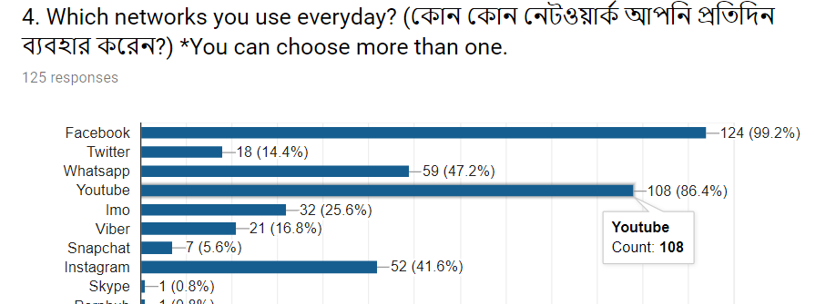
Our Survey result on most used Social networking sites

Slide 13
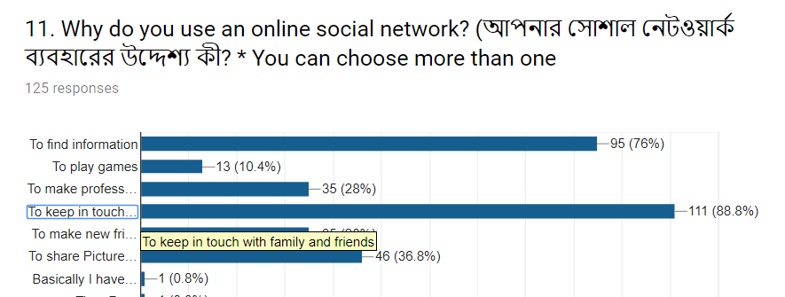
Survey result on peoples using reasons
MOSTLY TO FIND INFORMATION
To KEEP IN TOUCH WITH FAMILY AND FRIENDS
To make new friends
Sharing pictures
To make business contract

Slide 14
3.Positive Effects of Social Network
Amina Ahmed Jaya

Slide 15

Positive Impact on Social Media
Immediate access to information
A level playing field for business
In Touch With the World
Building Relationships
Speedy Communication

Slide 16
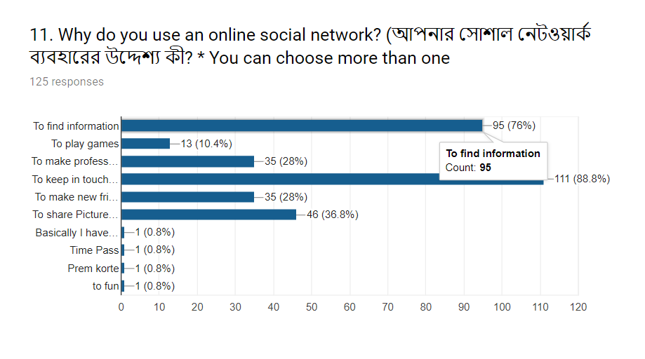
Let’s review some concepts

Slide 17
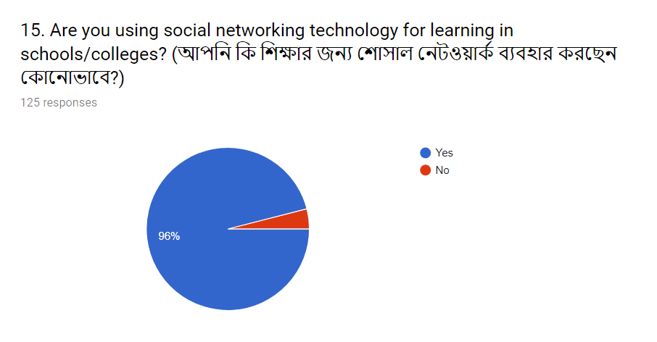

Slide 18
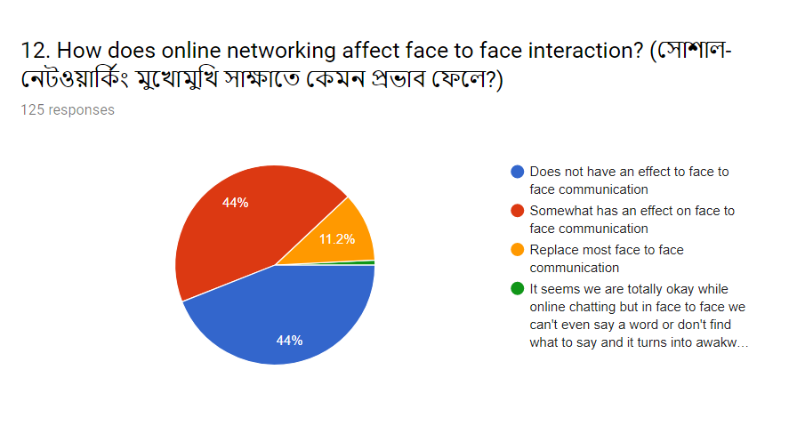

Slide 19
3. Negative Effects of Social Network
Nusrat Mehnaz Chowdhury

Slide 20


Negative Impacts
Education
Addiction
Effect on health
Time wastage
Cyber-bullying
Privacy
Reduced learning and research capabilities

Slide 21
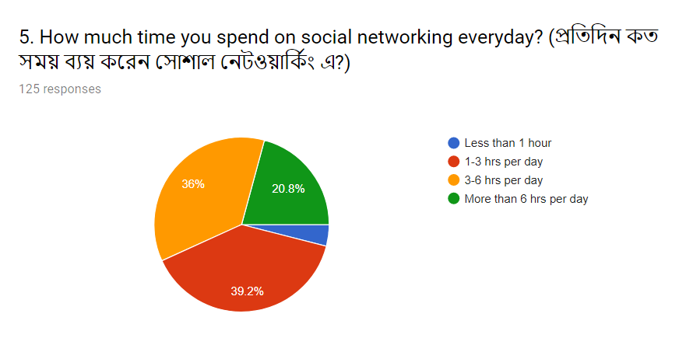
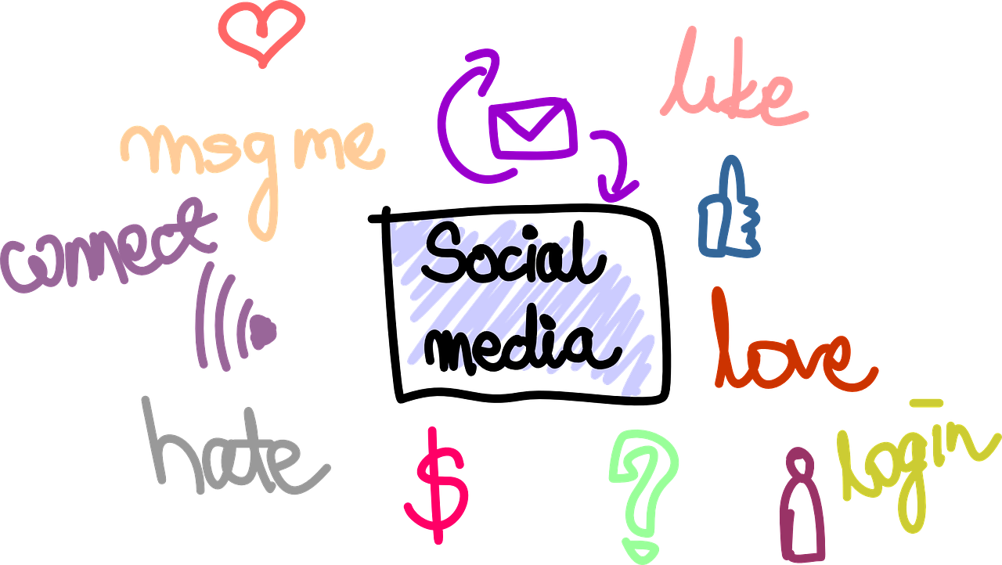
Our survey result on average time spend in Social Network

Slide 22


Slide 23
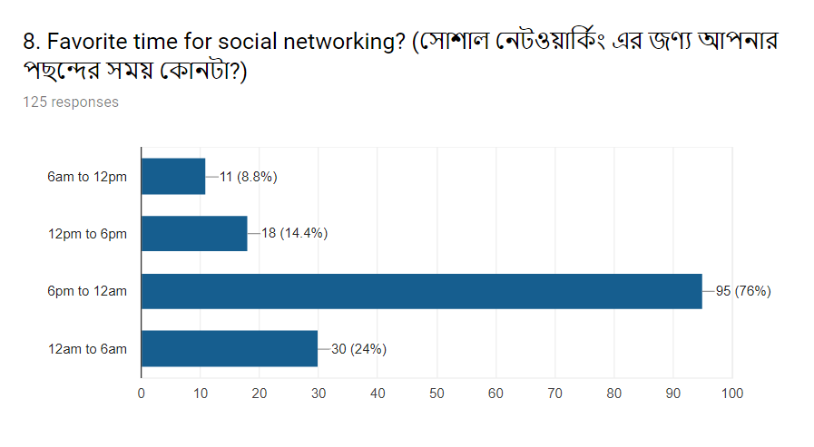

Slide 24
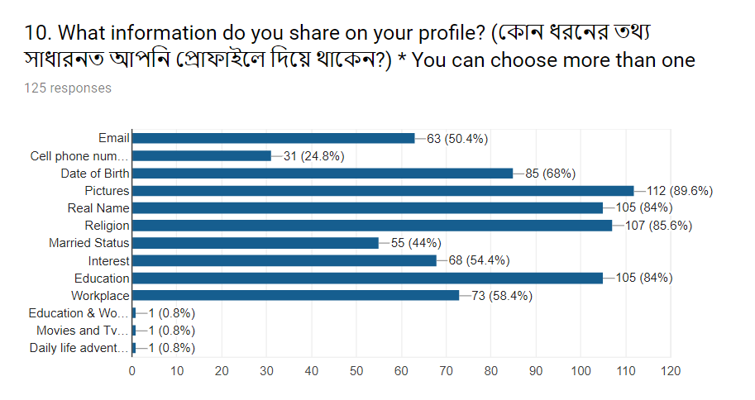

Slide 25
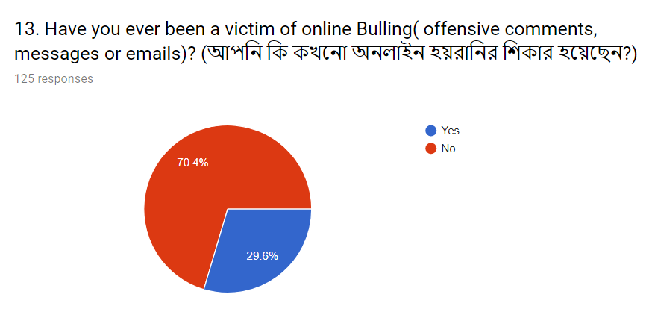


Slide 26

Future of social networking and challenges
Better Business Opportunity
Better communication
Better Marketing

Slide 27
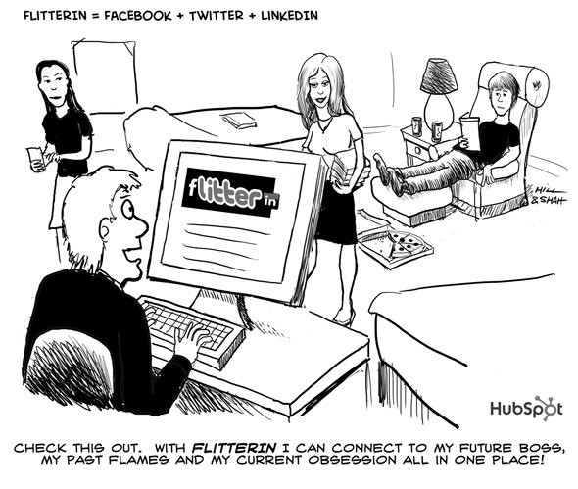

Slide 28
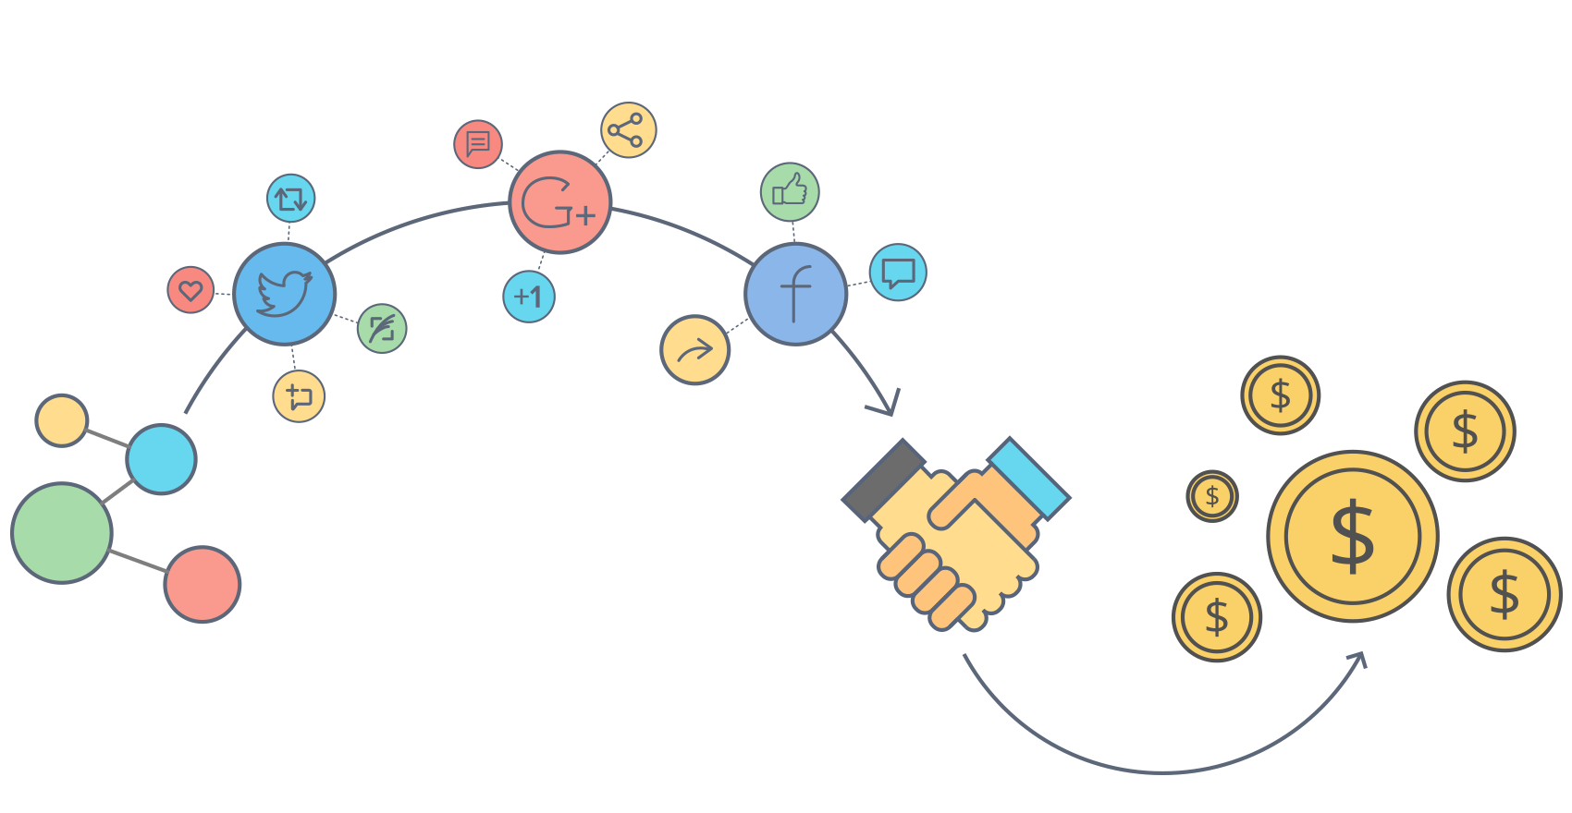
Conclusion
It helps people connect with their friends and make some new ones as well.
It helps people share what they are doing or details on where they are with the rest of the world.
It is also an avenue where you can order social media essay online or buy social media essay as well.

Slide 29
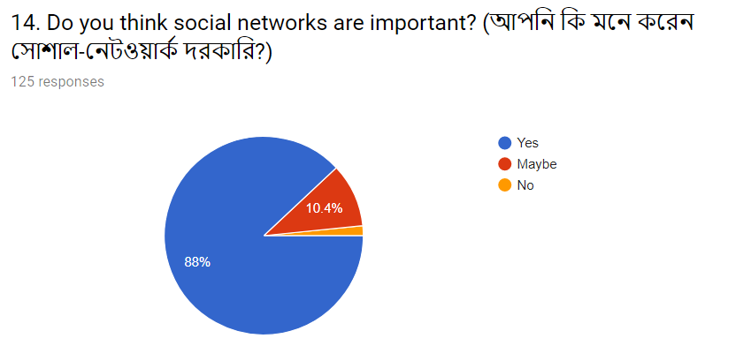
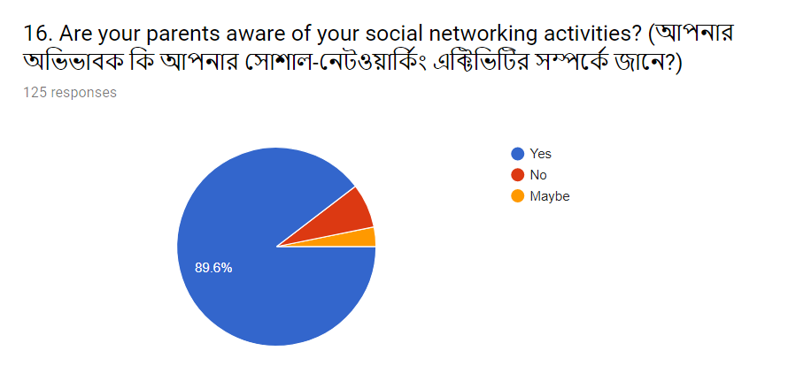

Slide 30


Slide 31
THANKS!
😉

